Slide 1
Python Object Orientation

Slide 2
Types of Things in Python
In general most python ‘things’ can be categorised as either a data Structure or a
data Operator. These are the building blocks of all python code.
Data Structure (for storing data)
Data Operator (for acting on data)
Variables:
Conditionals
Loops
Functions
Lists/arrays
Dictionaries
Note: Python libraries, imports etc. are all built on or replace the basic python
code structures – numpy arrays replace lists, matplotlib adds new functions

Slide 3
Types of Things in Python
In general most python ‘things’ can be categorised as either a data Structure or a
data Operator
Data Structure (for storing data)
Data Operator (for acting on data)
Variables:
Int (numbers)
String
Float (decimals)
Boolean (true/false)
Conditionals – if/else
Loops – for/while
Functions – def my_function
Lists/arrays – same thing in python
(set of multiple variables
stored together)
Dictionaries – Set of items grouped by
key - value

Slide 4
Types of Things in Python
In general most python ‘things’ can be categorised as either a data Structure or a
data Operator
Data Structure (for storing data)
Data Operator (for acting on data)
Variables:
Conditionals
Loops
Functions
Lists/arrays
Dictionaries
Python Objects
Store data as object parameters
Contain methods for acting on stored data

Slide 5
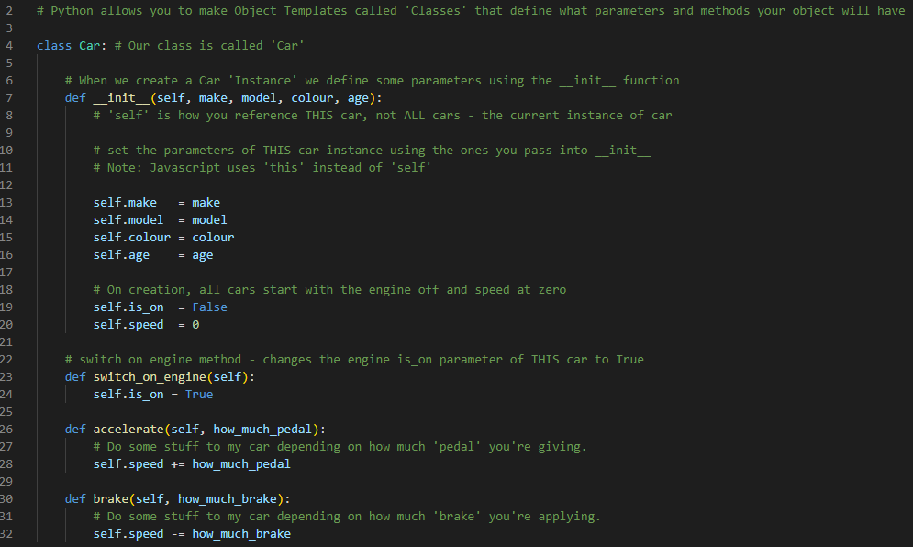
Python Objects
If you have a set of data of varying types it may be nice to group them together into a single easy-to-manipulate ‘object’. Objects have parameters for storing data and methods to act on data.
Example: Storing data on a car
Parameters:
- Make
- Model
- Colour
- Age
- Mileage
Methods:
- Accelerator
- Brake
- Switch on engine

Slide 6
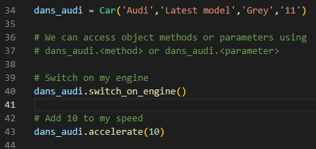
Object vs Instance – Difference?
The python object is the template for all class instances, where an instance is just one example of an object (e.g. Car – Object, Dan’s Audi – Instance)
In this example, ‘dans_audi’ is a specific instance of the class ‘Car’
A further example, x = 1. x is an ‘instance’ of the python class ‘int’. You can define multiple instances of the same class. E.g. x=1, y=2, z=26.
In the same way, multiple instances of the class ‘car’ can be defined.

Slide 7
Object Inherritance
Python classes can share code. This is particularly useful if you have some different classes which have some similarities but need their own methods as well.
Example: Habitat Rooms in an Extra Terrestrial (Lunar) Habitat:
We can create a virtual structure of a habitat using object instances.
- Single instance of the class ‘Habitat’ which contains a list of ‘Room’ instances.
Using the principle of inheritance, we can define different child classes of the parent class (‘Room’). E.g Kitchen, Sleeping Quarters, Bathrooms could all be child classes of the parent class Room)
We define some shared data and methods in the Room class that all the children will inherit, then we can define more stuff in each child class that’s specific to that type of room

Slide 8
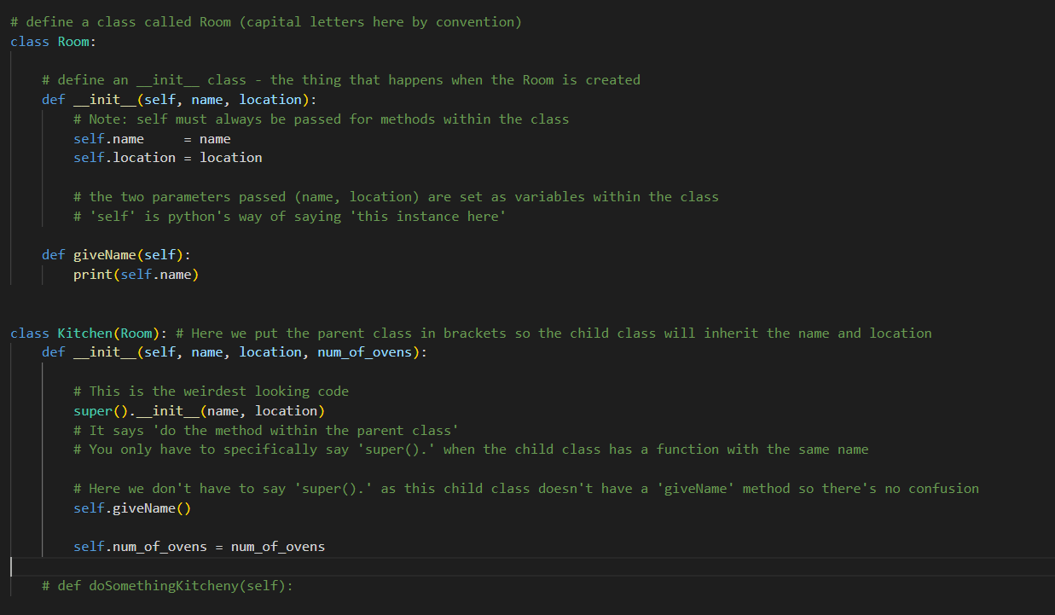
Example: Habitat Structure

